Slide 1
Don’t Call it iteracy
Herts / Bucks Teaching School Alliance
Staff Conference
7 July 2014
Twitter: @RealGeoffBarton
Download this presentation at www.geoffbarton.co.uk
(Presentation number 131)

Slide 2
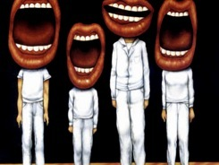
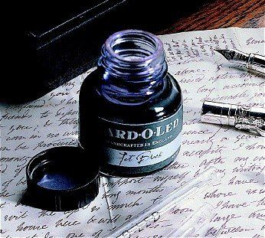

Slide 3
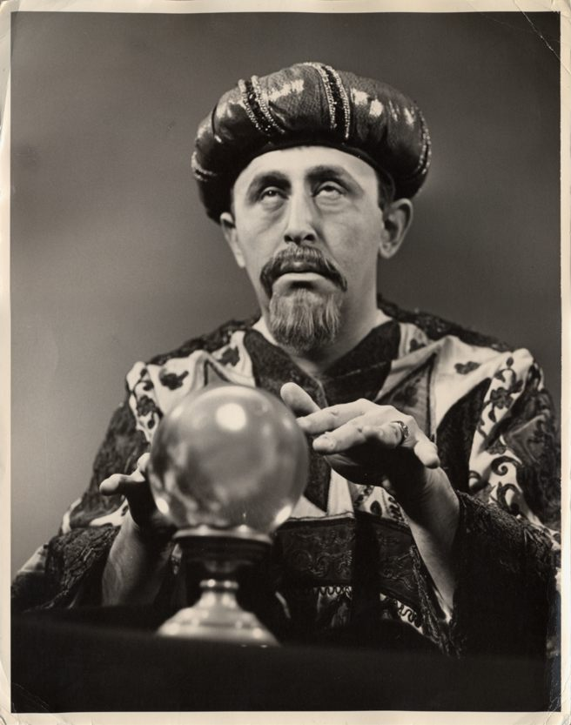
Bonus experience:
Today I will reveal the secret of literacy

Slide 4
WHAT

Slide 5
HOW

Slide 6
Structure:
Session 1: Why literacy matters to deep learning
Session 2: The Ofsted view
Session 3: Essentials for impact on learning:
- Speaking & Listening
- Reading
- Writing

Slide 7
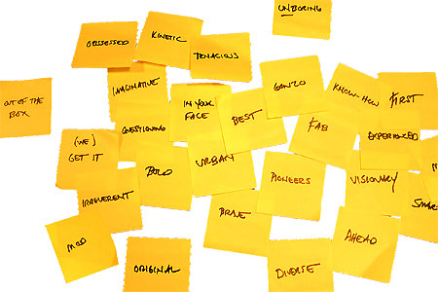
Approach:

Slide 8
Demo

Slide 9
Hypothesis:
Become a Year 11 writer again
… for five minutes

Slide 10
Hypothesis:
Task:
Describe the room we are in

Slide 11
Hypothesis:
3
Barriers to learning

Slide 12
Hypothesis:
1: Accuracy
2: Confidence
3: Interestingness

Slide 13
Teaching for Learning ….

Slide 14
Hypothesis:
Self-regulation

Slide 15
Hypothesis:
Interestingness:
Genres & modelling

Slide 16
Hypothesis:
Task:
Write an article for a newspaper arguing that school uniform is an outdated idea

Slide 17
Genre

Slide 18
Are tattoos a good thing?
Tony Parsons, Daily Mirror

Slide 19
AS soon as the sun starts shining, I realise with a sinking heart that Britain is now a tattooed nation. Tattoos are everywhere. You see them on firm young flesh and on wobbly, middle-aged flab, as common now on the school run and in the supermarket queue as they are on some footballer or his wife. I feel like the last man left alive whose skin crawls at the sight of these crass daubings. I wish it were just a celebrity fad. But when the Military Wives had the Christmas No 1 with their haunting ­Wherever You Are, their soloist, Samantha Stevenson, had so many hearts and flowers tattooed across her chest that she resembled a box of Cadbury’s Roses.

Slide 20
Are expensive overseas holidays a waste of money?
Jeremy Clarkson, Sunday Times

Slide 21
For your next holiday, why don’t you take all your money and put it on the fire? Then stand in a fridge for a week, beating your children with a baseball bat until their arms and legs break. And then, after you’ve eaten some melted cheese, dislocate your shoulder. If all of this appeals then you are probably one of the 1.3 million British people …
… who go on a skiing holiday at this time of year.

Slide 22
Model

Slide 23
Hypothesis:
Unconfident
Confident
What?
How?

Slide 24
Q:
?
Unconfident
Confident
Irrespective of background

Slide 25
A:
Teach them

Slide 26
Talking Point
Respite
What’s new? What’s familiar?
Implications for you and your subject?

Slide 27
Provocations:
We haven’t done literacy
It’s all about the classroom
Knowledge and instruction may be more important than we realised
Remember the “Matthew Effect”

Slide 28
The Matthew Effect
(Robert K Merton)

Slide 29
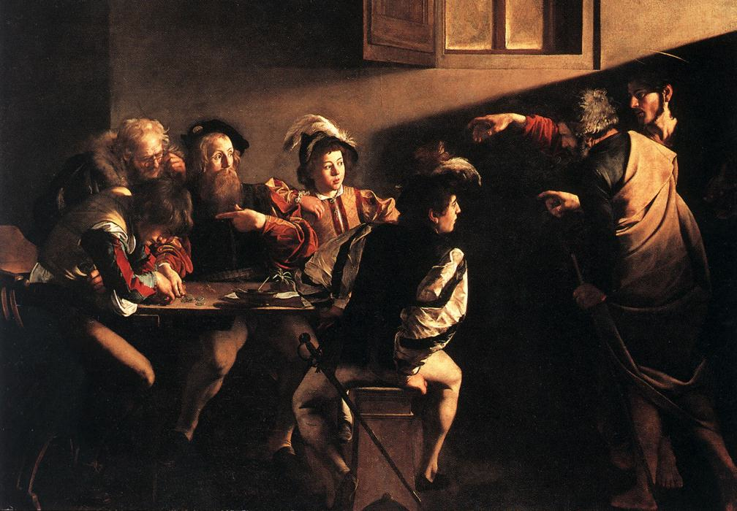

Slide 30
The rich shall get richer and the poor shall get poorer
Matthew 13:12

Slide 31
“The word-rich get richer while the word-poor get poorer” in their reading skills
(CASL)

Slide 32
“While good readers gain new skills very rapidly, and quickly move from learning to read to reading to learn, poor readers become increasingly frustrated with the act of reading, and try to avoid reading where possible”
The Matthew Effect
Daniel Rigney

Slide 33
“Students who begin with high verbal aptitudes find themselves in verbally enriched social environments and have a double advantage.”
The Matthew Effect
Daniel Rigney

Slide 34
“Good readers may choose friends who also read avidly while poor readers seek friends with whom they share other enjoyments”
The Matthew Effect
Daniel Rigney

Slide 35
Stricht’s Law: “reading ability in children cannot exceed their listening ability …”
E.D. Hirsch
The Schools We Need

Slide 36
“Spoken language forms a constraint, a ceiling not only on the ability to comprehend but also on the ability to write, beyond which literacy cannot progress”
Myhill and Fisher

Slide 37
“The children who possess intellectual capital when they first arrive at school have the mental scaffolding and Velcro to catch hold of what is going on, and they can turn the new knowledge into still more Velcro to gain still more knowledge”.
E.D. Hirsch
The Schools We Need

Slide 38
Aged 7:
Children in the top quartile have 7100 words; children in the lowest have around 3000.
The main influence is parents.
DfE Research Unit

Slide 39
The Matthew Effect:
The rich will get richer &
the poor will get poorer

Slide 40
The Literacy Club

Slide 41
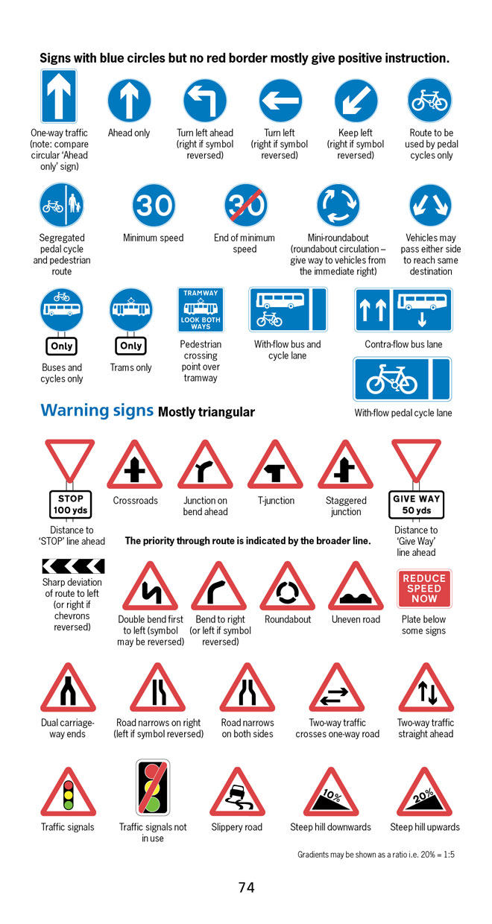
BBC NEWS ONLINE:
More than half of British motorists cannot interpret road signs properly, according to a survey by the Royal Automobile Club.
The survey of 500 motorists highlighted just how many people are still grappling with it.

Slide 42
5 key ingredients
Then teach you something
Then reflection

Slide 43
Understand the significance of exploratory talk
Model good talk – eg connectives
Re-think questioning – ‘why & how’, thinking time, and no-hands-up
Consciously vary groupings
Get conversation into the school culture

Slide 44
DEMO

Slide 45
Focus: speaking in public

Slide 46
Barriers:
Lack of confidence
Lack of structure
Lack of depersonalised tone

Slide 47
Task: why school uniform crushes our individuality

Slide 48
Stance, notes, pen
Number points
Be repetitive
Sentence functions
Confidence
Structure
Depersonalised tone
Avoid I / me
Use ‘so’, ‘because’, ‘however’ & ‘therefore’

Slide 49
Talking Point
Understand the significance of exploratory talk
Model good talk – eg connectives
Re-think questioning – ‘why & how’, thinking time, and no-hands-up
Consciously vary groupings
Get conversation into the school culture
What are the main types of talk needed in your subject?
Barriers?
So what could you do?

Slide 50
Teach reading – scanning, skimming, analysis
Read aloud and display
Teach key vocabulary
Demystify spelling
Teach research, not FOFO

Slide 51
DEMO

Slide 52
SKIMMING

Slide 53
The climate of the Earth is always changing. In the past it has altered as a result of natural causes. Nowadays, however, the term climate change is generally used when referring to changes in our climate which have been identified since the early part of the 1900's . The changes we've seen over recent years and those which are predicted over the next 80 years are thought to be mainly as a result of human behaviour rather than due to natural changes in the atmosphere.

Slide 54
The best treatment for mouth ulcers. Gargle with salt water. You should find that it works a treat. Salt is cheap and easy to get hold of and we all have it at home, so no need to splash out and spend lots of money on expensive mouth ulcer creams.

Slide 55
Lexical v Grammatical Words

Slide 56
Urquhart castle is probably one of the most picturesquely situated castles in the Scottish Highlands. Located 16 miles south-west of Inverness, the castle, one of the largest in Scotland, overlooks much of Loch Ness. Visitors come to stroll through the ruins of the 13th-century castle because Urquhart has earned the reputation of being one of the best spots for sighting Loch Ness’s most famous inhabitant.

Slide 57
Urquhart castle is probably one of the most picturesquely situated castles in the Scottish Highlands. Located 16 miles south-west of Inverness, the castle, one of the largest in Scotland, overlooks much of Loch Ness. Visitors come to stroll through the ruins of the 13th-century castle because Urquhart has earned the reputation of being one of the best spots for sighting Loch Ness’s most famous inhabitant.

Slide 58
Urquhart castle is probably one of the most picturesquely situated castles in the Scottish Highlands. Located 16 miles south-west of Inverness, the castle, one of the largest in Scotland, overlooks much of Loch Ness. Visitors come to stroll through the ruins of the 13th-century castle because Urquhart has earned the reputation of being one of the best spots for sighting Loch Ness’s most famous inhabitant.

Slide 59
Urquhart castle is probably one of the most picturesquely situated castles in the Scottish Highlands. Located 16 miles south-west of Inverness, the castle, one of the largest in Scotland, overlooks much of Loch Ness. Visitors come to stroll through the ruins of the 13th-century castle because Urquhart has earned the reputation of being one of the best spots for sighting Loch Ness’s most famous inhabitant.

Slide 60
Urquhart castle is probably one of the most picturesquely situated castles in the Scottish Highlands. Located 16 miles south-west of Inverness, the castle, one of the largest in Scotland, overlooks much of Loch Ness. Visitors come to stroll through the ruins of the 13th-century castle because Urquhart has earned the reputation of being one of the best spots for sighting Loch Ness’s most famous inhabitant.

Slide 61
SCANNING

Slide 62
Where did the first cell phones begin?
Name 2 other features that started to be included in phones
Why are cell phones especially useful in some countries?

Slide 63
Where begin?
Two features?
Some countries?
Cellular telephones
The first cellular telephone system began operation in Tokyo in 1979, and the first U.S. system began operation in 1983 in Chicago. A camera phone is a cellular phone that also has picture taking capabilities. Some camera phones have the capability to send these photos to another cellular phone or computer. Advances in digital technology and microelectronics has led to the inclusion of unrelated applications in cellular telephones, such as alarm clocks, calculators, Internet browsers, and voice memos for recording short verbal reminders, while at the same time making such telephones vulnerable to certain software viruses. In many countries with inadequate wire-based telephone networks, cellular telephone systems have provided a means of more quickly establishing a national telecommunications network.

Slide 64
CLOSE READING

Slide 65
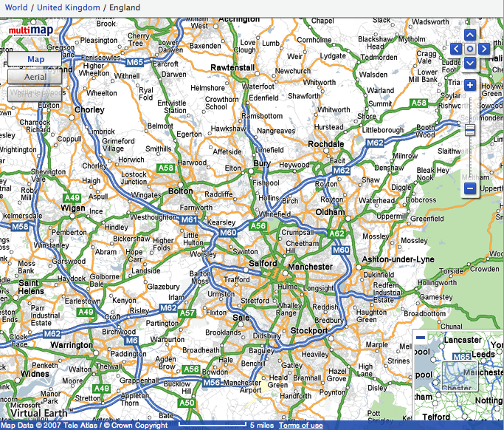

Slide 66
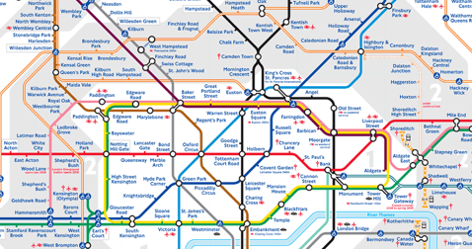
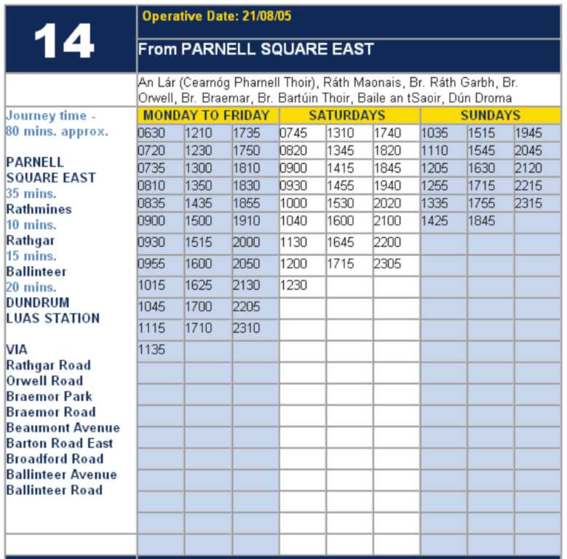

Slide 67
RESEARCH SKILLS

Slide 68
Research the life of
Martin Luther King

Slide 69
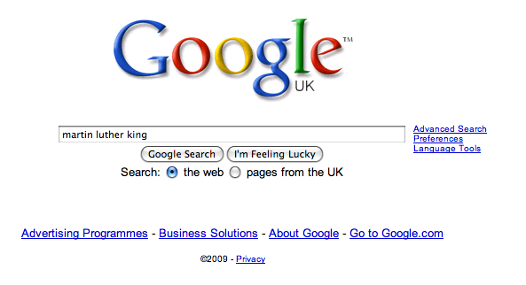

Slide 77
DEMYSTIFYING
SPELLING
3
Notes:
7 spellings: Government – February – parliament – separate – believe – necessary - accommodation

Slide 78
1 - SOUNDS

Slide 79
Government

Slide 80
February

Slide 81
Parliament

Slide 82
2 -VISUALS

Slide 83
Se-para-te
Be-lie-ve

Slide 84
3 - MNEMONICS

Slide 85
necessary

Slide 86
accommodation

Slide 87
Talking Point
Teach reading – scanning, skimming, analysis
Read aloud and display
Teach key vocabulary
Demystify spelling
Teach research, not FOFO
What are the main types of reading needed in your subject?
Barriers?
So what could you do?

Slide 88
Demonstrate writing
Teach composition & planning
Allow oral rehearsal
Short & long sentences
Connectives

Slide 89
Know your connectives
Adding: and, also, as well as, moreover, too
Cause & effect: because, so, therefore, thus, consequently
Sequencing: next, then, first, finally, meanwhile, before, after
Qualifying: however, although, unless, except, if, as long as, apart from, yet
Emphasising: above all, in particular, especially, significantly, indeed, notably
Illustrating: for example, such as, for instance, as revealed by, in the case of
Comparing: equally, in the same way, similarly, likewise, as with, like
Contrasting: whereas, instead of, alternatively, otherwise, unlike, on the other hand

Slide 90
Demonstrate writing
Teach composition & planning
Allow oral rehearsal
Short & long sentences
Connectives

Slide 91
DEMO

Slide 92
Task: write a horror story set in a mundane setting

Slide 93
Barriers:
Predictability
Telling, not showing
Lack of narrative ambition

Slide 94
Be sensuous; reject first word; use pronouns
Experiment with point-of-view
Predictability
Telling, not showing
Lack of narrative ambition
Use narrative disjuncture

Slide 95
Talking Point
Demonstrate writing
Teach composition & planning
Allow oral rehearsal
Short & long sentences
Connectives
What are the main types of writing needed in your subject?
Barriers?
So what could you do?

Slide 97
Don’t Call it iteracy
Herts / Bucks Teaching School Alliance
Staff Conference
7 July 2014
Twitter: @RealGeoffBarton
Download this presentation at www.geoffbarton.co.uk
(Presentation number 131)

